Slide 1
MATHEMATICAL INTELLIGENCE SYSTEM
GROUP-ASSIGNMENT-1

Slide 2
CONTRIBUTED BY: -
BATCH-A | TEAM-7
GAJULA SRI VATSANKA | CB.EN.U4AIE.21010
GUNNAM HIMAMSH | CB.EN.U4AIE.21014
M.PRASANNA TEJA | CB.EN.U4AIE.21035
VIKHYAT BANSAL | CB.EN.U4AIE.21076

Slide 3
LINEAR ALGEBRA
Dr. NAVANEETH HARIDHARSHAN

Slide 4
Write a code in a programming language to do the PA = LU decomposition of a m x n matrix A.
1
VIKHYAT BANSAL

Slide 5
LU Decomposition
In numerical analysis and linear algebra, lower–upper (LU) decomposition or factorization as it factors a matrix as the product of a lower triangular matrix and an upper triangular matrix. The product sometimes includes a permutation matrix(P) as well. LU decomposition can be viewed as the matrix form of Gaussian elimination. Computers usually solve square systems of linear equations using LU decomposition, and it is also a key step when inverting a matrix or computing the determinant of a matrix.

Slide 6
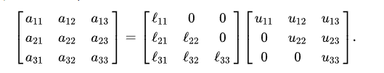
Let A be a square matrix. An LU factorization refers to the factorization of A, with proper row and/or column orderings or permutations, into two factors – a lower triangular matrix L and an upper triangular matrix U
A = LU
In the lower triangular matrix all elements above the diagonal are zero, in the upper triangular
matrix, all the elements below the diagonal are zero. For example, for a 3 × 3 matrix A, its LU
decomposition looks like this:
Without a proper ordering or permutations in the matrix, the factorization may fail to materialize.
For example, it is easy to verify (by expanding the matrix multiplication) that
If a₁₁ = 0, then atleast one of l₁₁ and u₁₁ has to be zero, which implies that either L or U is singular.
This is impossible if A is an invertible matrix. This is a common problem and can be removed by
simply reordering the rows of A so that the first element of the matrix is non-zero.

Slide 7
LU factorization with partial pivoting
It turns out that a proper permutation in rows (or columns) is sufficient for LU factorization. LU factorization with partial pivoting (LUP) refers often to LU factorization with row permutations only.
PA = LU
where L and U are again lower and upper triangular matrices, and P is a permutation
matrix, which, when left-multiplied to A, reorders the rows of A. It turns out that all
square matrices can be factorized in this form, and the factorization is numerically
stable in practice. This makes LUP decomposition a useful technique in practice.

Slide 8
Solving of NxN matrix for LU Decomposition

Slide 9
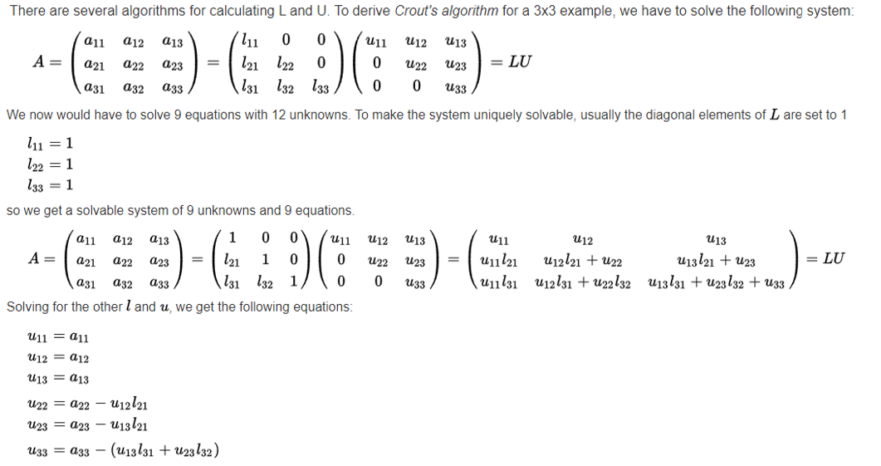

Slide 10
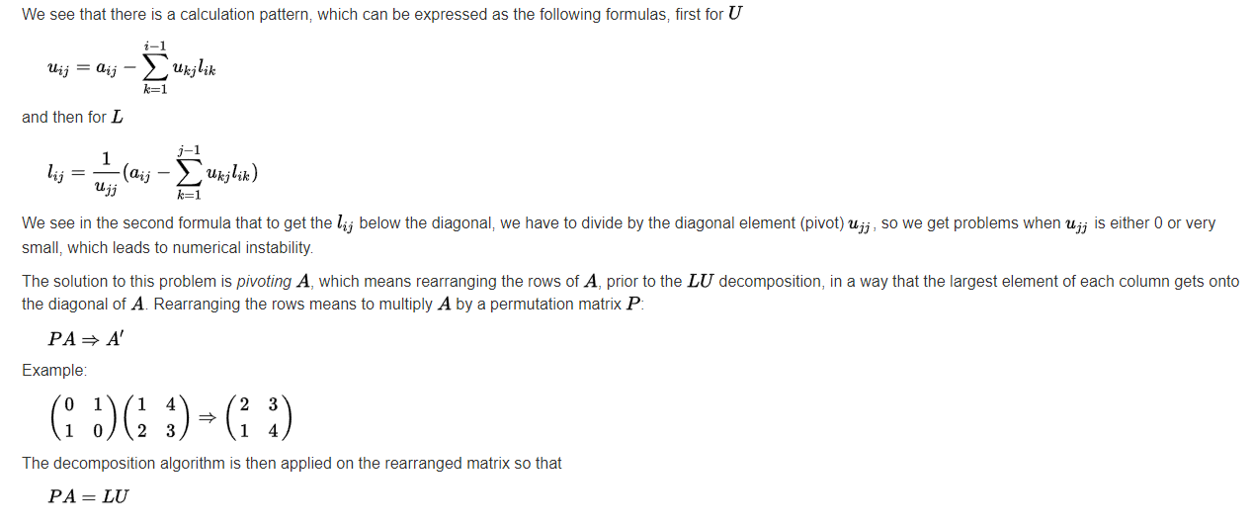

Slide 11
Solving of MxN matrix for LU Decomposition

Slide 12
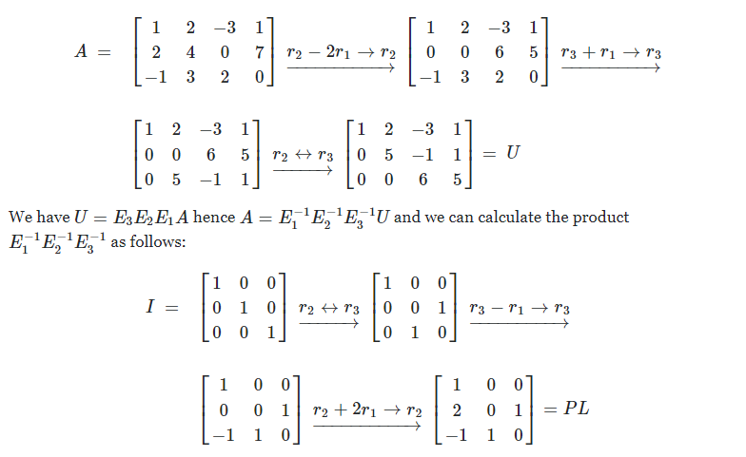
Understanding LU decomposition of 3x4 Matrix will give us a overview of how LU decomposition of rectangular matrix. The method works just as well for other sizes since the LU-decomposition arises naturally from the study of Gaussian elimination via multiplication by elementary matrices.

Slide 13
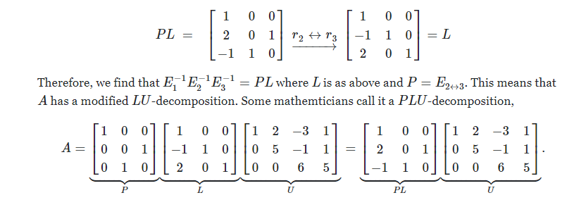
A"P“ is inserted in front of the L since the matrix above is not lower triangular. However, if we go one step further and let r2↔r3 then we will obtain a lower triangular matrix:

Slide 14
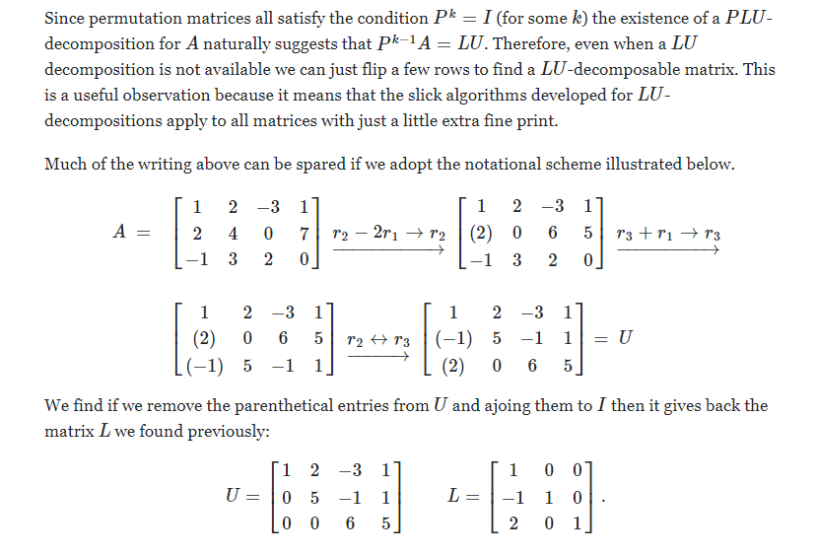

Slide 15
Java Code for LU decomposition Matrices

Slide 16
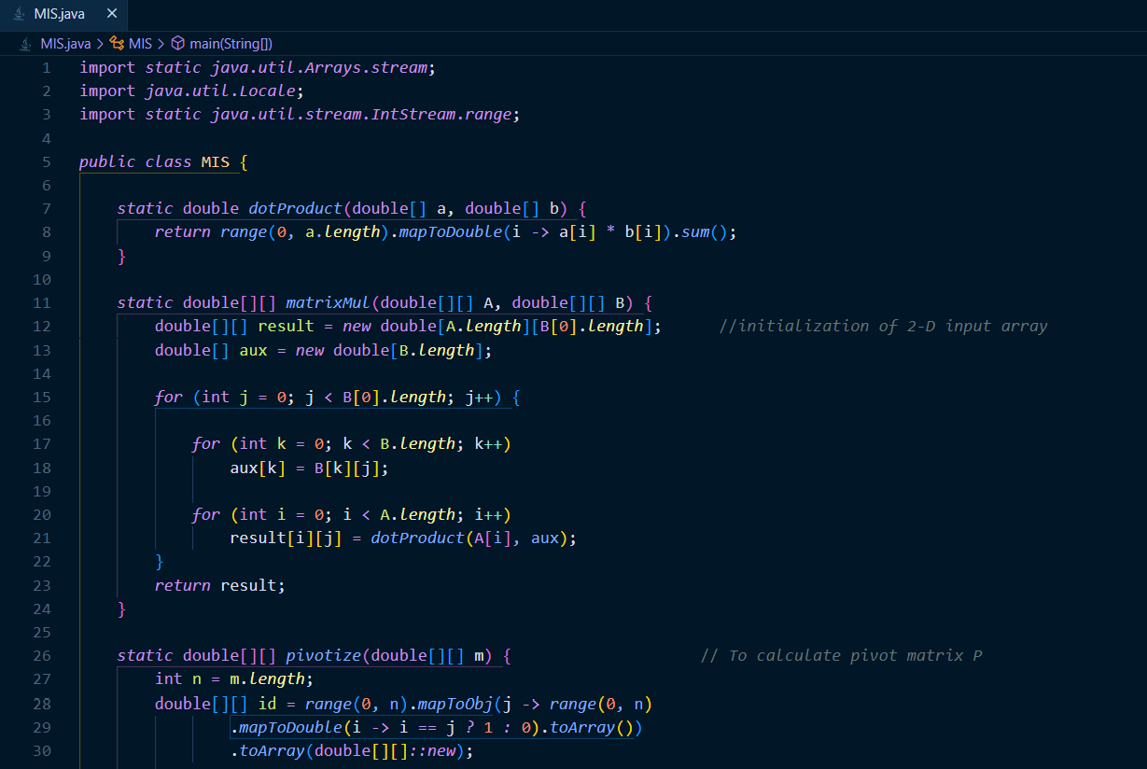

Slide 17
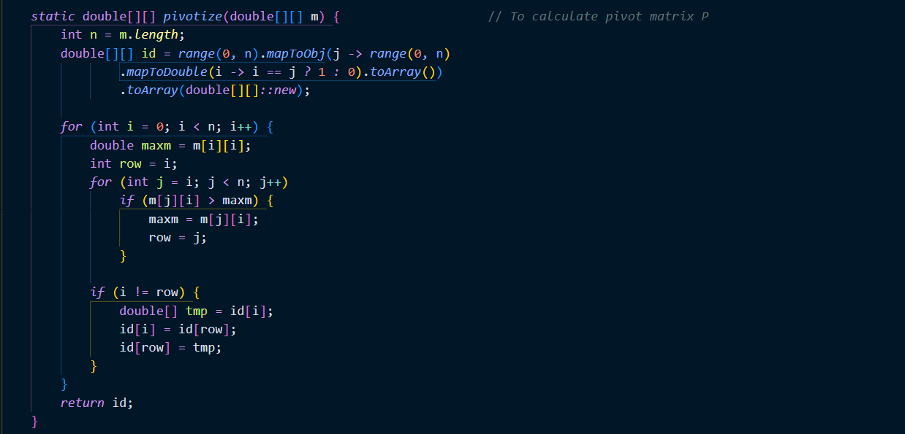

Slide 18
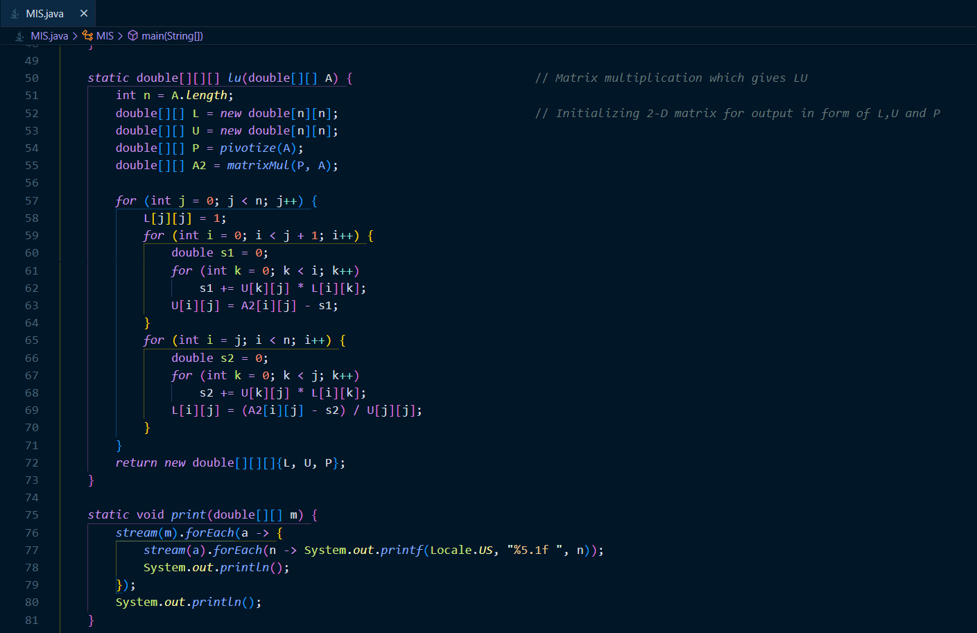

Slide 19
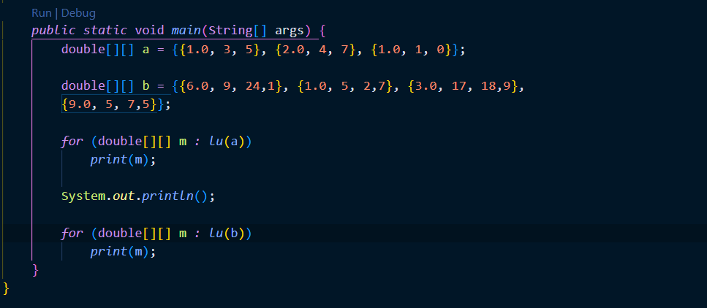

Slide 20
Output for LU decomposition Matrices

Slide 21
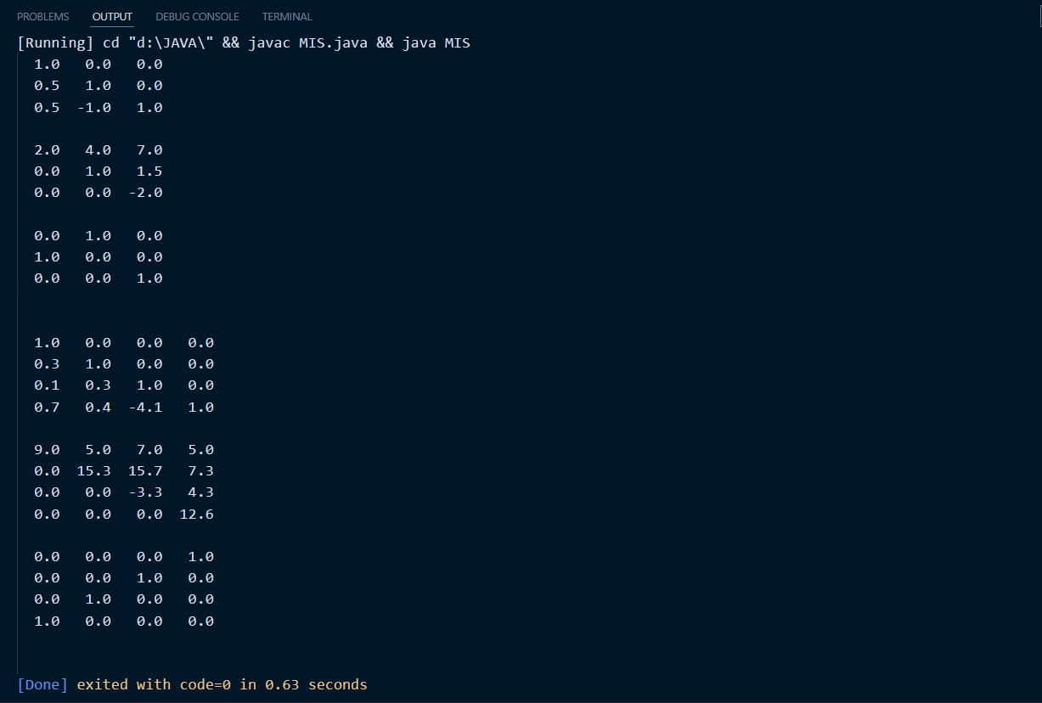

Slide 22
Python Code for LU decomposition Matrices

Slide 23
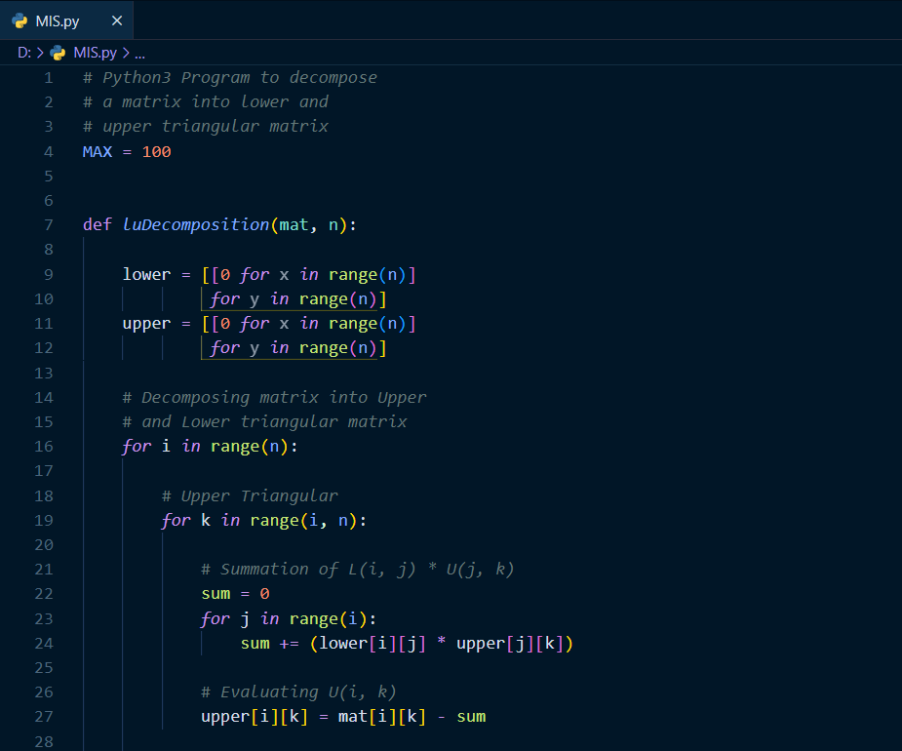

Slide 24
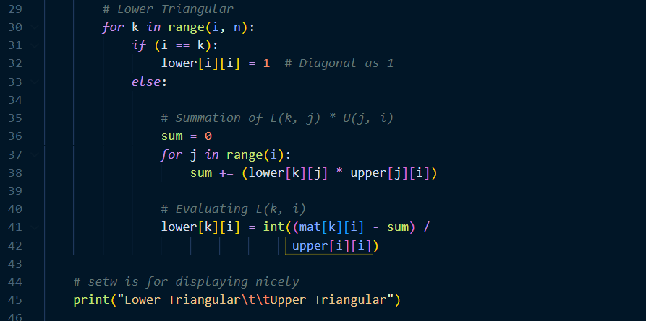

Slide 25
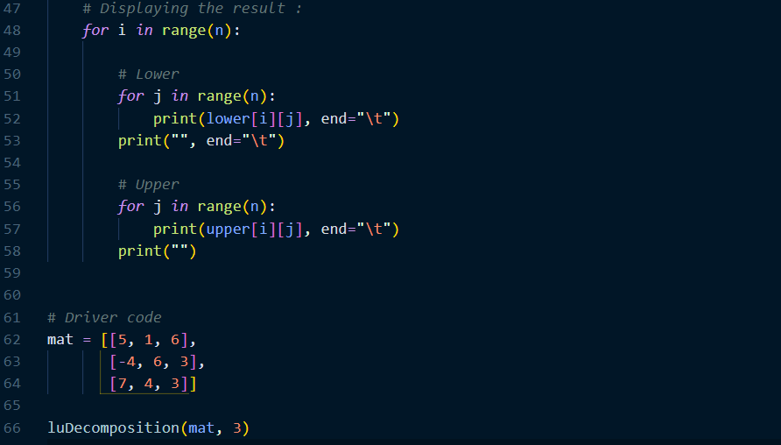

Slide 26
Output for LU decomposition Matrices

Slide 27
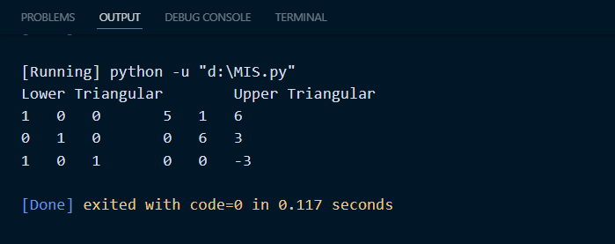

Slide 28
Write a code in a programming language to do A = QR decomposition for a given m x n matrix A. Also do the least square fitting of the problem in the medium article using the decomposition.
2
HIMAMSH & M.PRASANNA TEJA

Slide 29
QR DECOMPOSITION
QR decomposition is a decomposition of a matrix A into a product A = QR of an orthogonal matrix Q and an upper triangular matrix R.
QR decomposition is often used to solve the linear least squares problem and is the basis for a particular eigenvalue algorithm
A = QR
A is a square matrix
Q is an orthogonal matrix
R is an upper triangular matrix

Slide 30
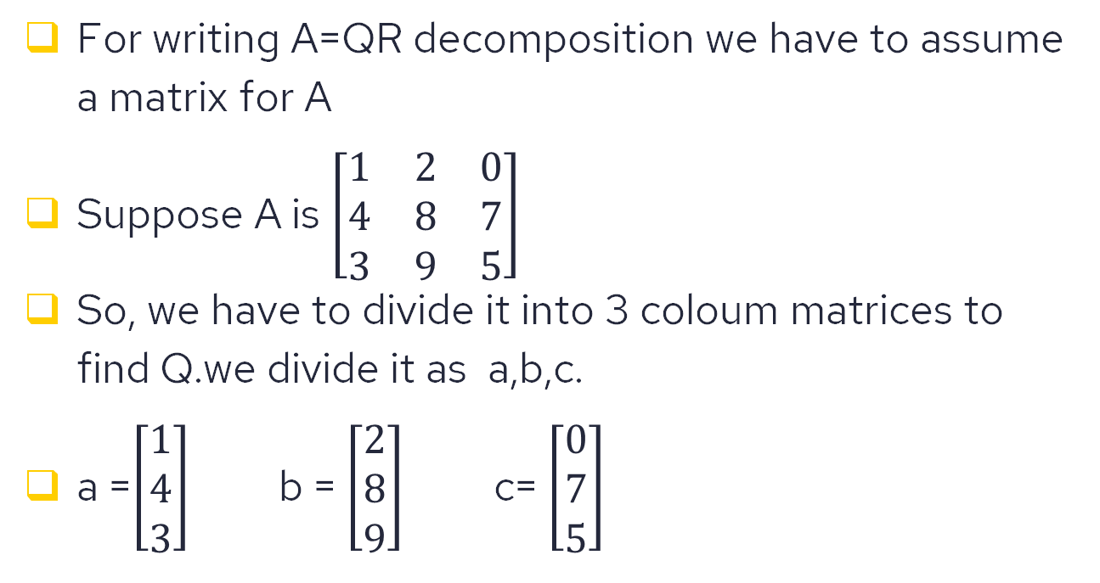
For writing A=QR decomposition we have to assume a matrix for A
Suppose A is $\left[\begin{matrix}1 & 2 & 0 \\ 4 & 8 & 7 \\ 3 & 9 & 5\end{matrix}\right]$
So, we have to divide it into 3 coloum matrices to find Q.we divide it as a,b,c.
a =$\left[\begin{matrix}1 \\ 4 \\ 3\end{matrix}\right]$ b = $\left[\begin{matrix}2 \\ 8 \\ 9\end{matrix}\right]$ c= $\left[\begin{matrix}0 \\ 7 \\ 5\end{matrix}\right]$

Slide 31
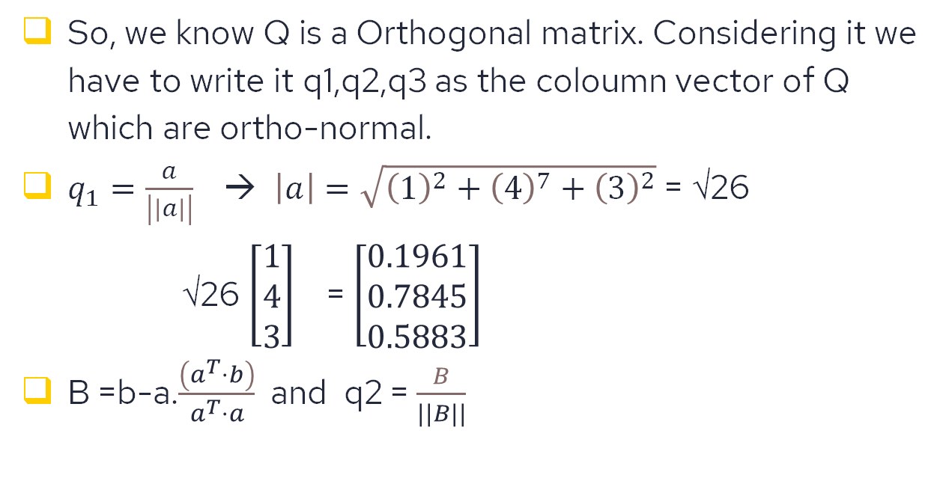
So, we know Q is a Orthogonal matrix. Considering it we have to write it q1,q2,q3 as the coloumn vector of Q which are ortho-normal.
$q_{1}=\frac{a}{\left|\left|a\right|\right|}$ → $\left|a\right|=\sqrt{{\left(1\right)}^{2}+{\left(4\right)}^{7}+{\left(3\right)}^{2}}$ = √26
√26 $\left[\begin{matrix}1 \\ 4 \\ 3\end{matrix}\right]$ = $\left[\begin{matrix}0.1961 \\ 0.7845 \\ 0.5883\end{matrix}\right]$
B =b-a.$\frac{\left(a^{T}⋅b\right)}{a^{T}⋅a}$ and q2 = $\frac{B}{||B||}$

Slide 32
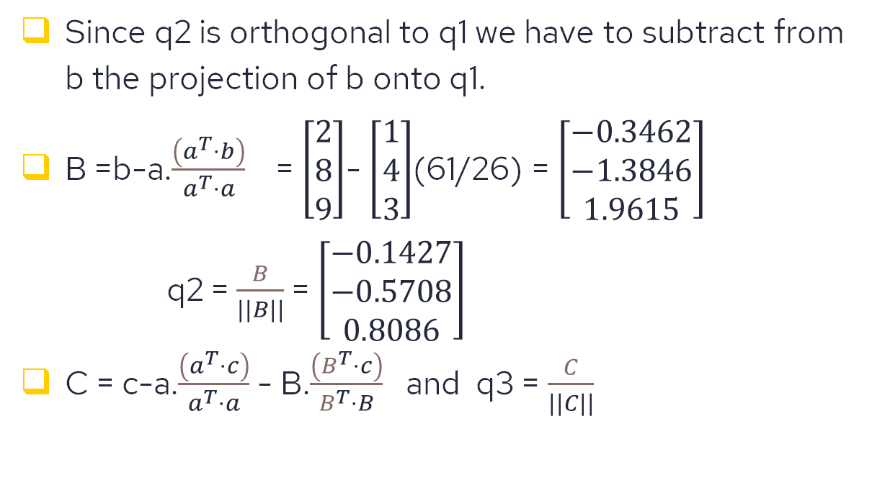
Since q2 is orthogonal to q1 we have to subtract from b the projection of b onto q1.
B =b-a.$\frac{\left(a^{T}⋅b\right)}{a^{T}⋅a}$ = $\left[\begin{matrix}2 \\ 8 \\ 9\end{matrix}\right]$- $\left[\begin{matrix}1 \\ 4 \\ 3\end{matrix}\right]$(61/26) = $\left[\begin{matrix}−0.3462 \\ −1.3846 \\ 1.9615\end{matrix}\right]$
q2 = $\frac{B}{||B||}$ = $\left[\begin{matrix}−0.1427 \\ −0.5708 \\ 0.8086\end{matrix}\right]$
C = c-a.$\frac{\left(a^{T}⋅c\right)}{a^{T}⋅a}$ - B.$\frac{\left(B^{T}⋅c\right)}{B^{T}⋅B}$ and q3 = $\frac{C}{||C||}$

Slide 33
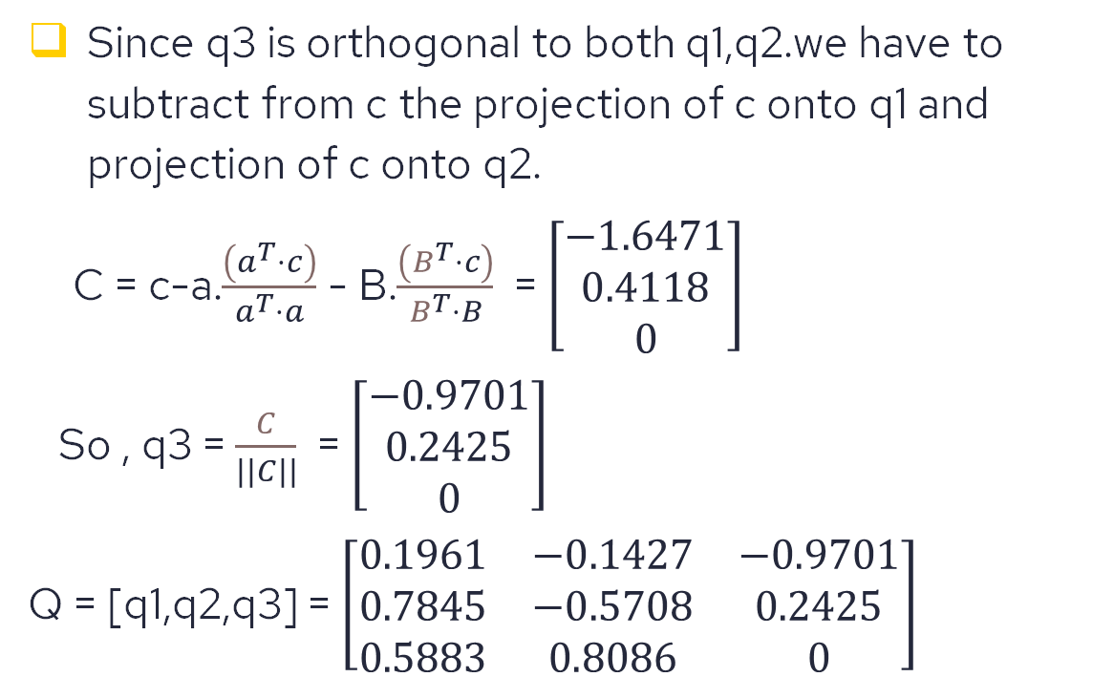
Since q3 is orthogonal to both q1,q2.we have to subtract from c the projection of c onto q1 and projection of c onto q2.
C = c-a.$\frac{\left(a^{T}⋅c\right)}{a^{T}⋅a}$ - B.$\frac{\left(B^{T}⋅c\right)}{B^{T}⋅B}$ = $\left[\begin{matrix}−1.6471 \\ 0.4118 \\ 0\end{matrix}\right]$
So , q3 = $\frac{C}{||C||}$ = $\left[\begin{matrix}−0.9701 \\ 0.2425 \\ 0\end{matrix}\right]$
Q = [q1,q2,q3] = $\left[\begin{matrix}0.1961 & −0.1427 & −0.9701 \\ 0.7845 & −0.5708 & 0.2425 \\ 0.5883 & 0.8086 & 0\end{matrix}\right]$

Slide 34
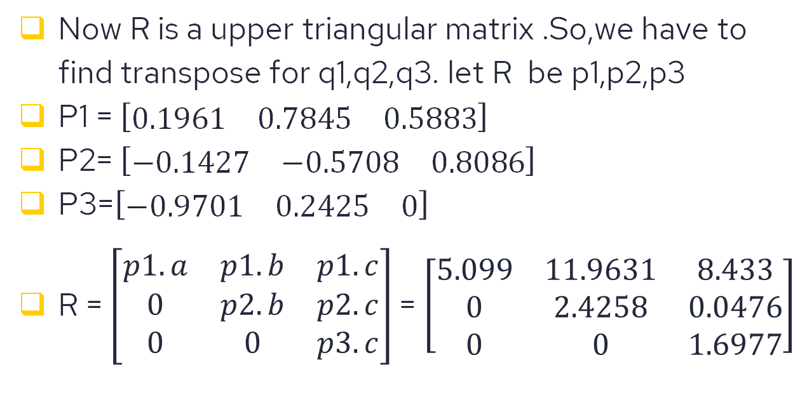
Now R is a upper triangular matrix .So,we have to find transpose for q1,q2,q3. let R be p1,p2,p3
P1 = $\left[\begin{matrix}0.1961 & 0.7845 & 0.5883\end{matrix}\right]$
P2= $\left[\begin{matrix}−0.1427 & −0.5708 & 0.8086\end{matrix}\right]$
P3=$\left[\begin{matrix}−0.9701 & 0.2425 & 0\end{matrix}\right]$
R = $\left[\begin{matrix}p1.a & p1.b & p1.c \\ 0 & p2.b & p2.c \\ 0 & 0 & p3.c\end{matrix}\right]$= $\left[\begin{matrix}5.099 & 11.9631 & 8.433 \\ 0 & 2.4258 & 0.0476 \\ 0 & 0 & 1.6977\end{matrix}\right]$

Slide 35
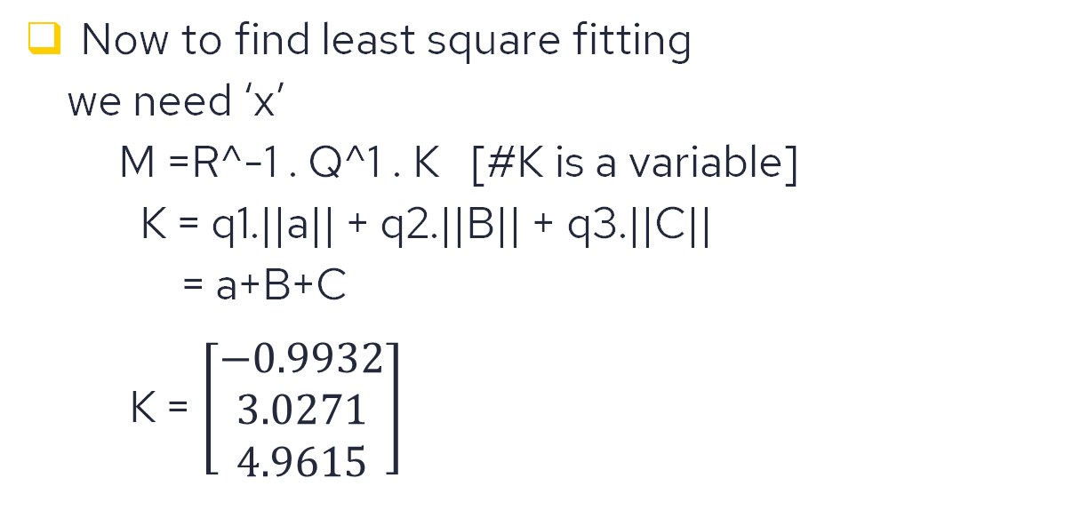
Now to find least square fitting
we need ‘x’
M =R^-1 . Q^1 . K [#K is a variable]
K = q1.||a|| + q2.||B|| + q3.||C||
= a+B+C
K = $\left[\begin{matrix}−0.9932 \\ 3.0271 \\ 4.9615\end{matrix}\right]$

Slide 36

M=R^-1 . Q^1 . K
M = $\left[\begin{matrix}−2.9540 \\ 0.9240 \\ 1\end{matrix}\right]$
We will see the code of this in next slide.

Slide 37
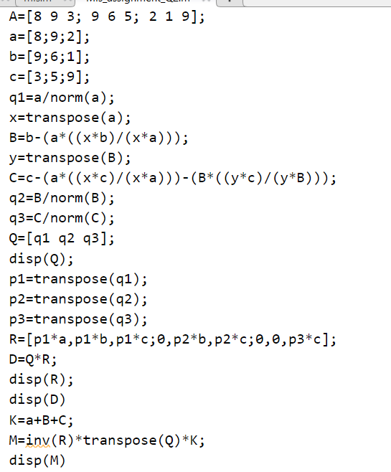

Slide 38
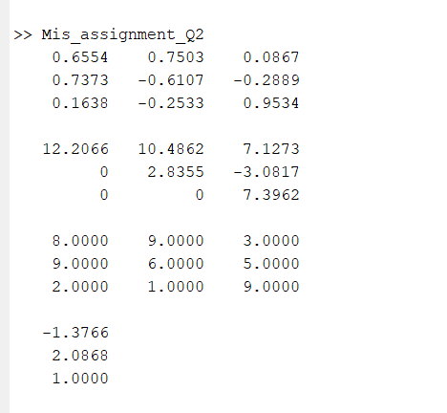

Slide 39
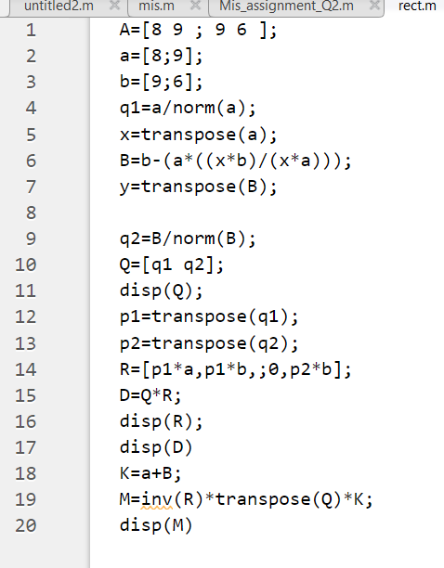
Solving the same by rectangular matrix

Slide 40
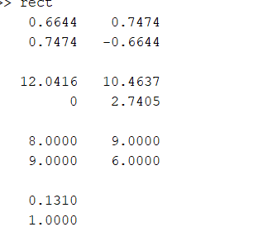
Output

Slide 41
As the process has been explained in the previous slides we used the same concept for doing rectangular too but we have used 3*2 matrix instead of 3*3 matrix as we require rectangular matrix

Slide 42
PROBABILITY
Dr. NIMAL MADHU

Slide 43
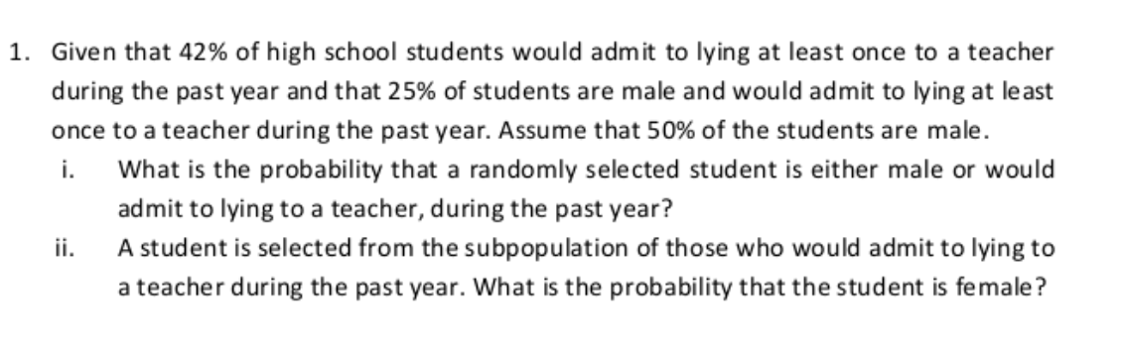
1
GUNNAM HIMAMSH and VIKHYAT BANSAL

Slide 44
SOLUTION
Event A = student admit lying to teacher at least once during past year
Event M = student who is selected is a male
Event(A∩M) = student who admit lying to teacher during past year is a male
Event F = student who is selected is a female

Slide 45
So as given in the question students who admit lying is 42%, student selected is a male is 50% and student who admit lying is a boy is 25%
Then the probability of occurring event A will be 42%
Then the probability of occurring event M will be 50%
Then the probability of occurring event (A∩M) will be 25%
P(A) = 0.42
P(M) = 0.50
P(F) = 0.50
P(A∩M) = 0.25

Slide 46
i)The probability that a randomly selected student is either male or would admit lying to a teacher during the past year is given by P(A∪M) .
P(A∪M) = P(A) + P(M) - P(A∩M)
= 0.42 + 0.5 - 0.25
= 0.67
P(A∪M) = 0.67
ii)Now the probability that the selected student is a female given that student would admit to lying to a teacher during the past exam is given by P(F/A) and we can write
P(F/A) = 1 – P(M/A)
P(M/A)= P(A∩M)/P(A)
(Conditional probability formula)
=0.25/0.42

Slide 47
P(M/A) = 0.5952
Hence,
P(F/A) = 1 – P(M/A)
= 1 – 0.5952
P(F/A)= 0.4048
i) P(A∪M) = 0.67
ii) P(F/A)= = 0.4048

Slide 48
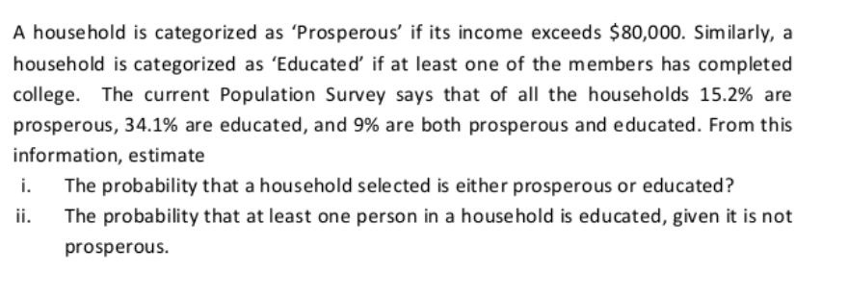
2
M.PRASANNA TEJA

Slide 49
Answer
Probability of a family being NOT prosperous is P(not pros) = 1-0.152 = 0.848
Probability of a family being prosperous and educated
P(not pros∩ edu) = P(edu) – P(pros ∩ edu)
= 0.341 – 0.09 = 0.251

Slide 50
Let the probability of the event, atleast one person in a household is educated given it is not prosperous be P(B)
P(B) = P(pros U edu) = P(not pros ∩ edu) / P(not pros)
= 0.251 / 0.848
= 0.296

Slide 51
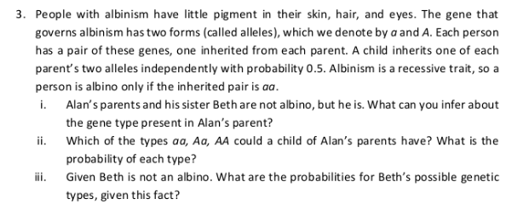
3
GAJULA SRI VATSANKA

Slide 52
i) According to the given question ,there are 4 different gene
types: aa,aA,AA,Aa
Now, we have been given that Alan is an albino ,so he must be of the gene type of "aa".
As Alan parents are not albinos, there gene type probably should be "Aa“, “Aa” or “AA” and cannot be “aa”.
Since Alan is an albino ,if anyone of his parent's gene is AA ,he won't be an Albino.
INFERENCE: So, it's mentioned that his(Alan’s) genes make him Albino ,which means their(parent’s) gene type is either "Aa" or "aA“ but neither “AA” nor “aa”.

Slide 53
As we know that Alan's parent can't have a gene type of "aa“.
So, the probability of Alan's parent's child having the gene type
1) aa, P(aa) = 1/4
2) AA, P(AA) =1/4
3) Aa, P(Aa) =1/4
4) aA, P(aA) =1/4
A child of Alan parent's can have all the 4 possible combination of gene types.
Also if Aa and aA are same gene types P(Aa)=P(aA)=1/2

Slide 54
iii)
Alan's parent can have gene type of "Aa" and "aA". As Beth is not an Albino, Probability of her having the gene type is:
1) aA, P(aA)=1/3
2) Aa, P(Aa)=1/3
3) AA, P(AA)=1/3
if Aa and aA are same gene types
P(aA)=2/3 : P(Aa)=2/3
P(Aa)=P(aA)=P(AA)=1/3 ,since she can contain only 3 gene types.
As this selection of any one type of gene among the possible 3 gene types will be equal to 1/3

Slide 55
THANK YOU

